Slide 1
Warm up ideas
Warm ups need to be fun! I don’t like to have any chasing games - they are more relevant
for games lessons.
Children need to think about space and sharing it with others, moving in different ways,
travelling in different directions, following different pathways. Sometimes warm ups will be
topical or they might link with maths or literacy.

Slide 2
DODGEMS
Children move around and hold onto their marker – they must not touch anyone else
SEEK YOUR SPOT
Each child puts their marker into a space, and sit on it.
A few children are chosen to leave marker and move around, until signal and then return to marker. (Develop by adding different ways of travelling e.g. bouncing, giant strides, gallops, monkey walks…)
FISHES As above but half the group remain seated, as rocks, whilst other half tip-toe (swim like fish in a rock pool) in and out of the seated children- avoiding the rocks.
THE TIDE IS COMING IN As above but children hopping skipping, jumping etc. on the beach between the sandcastles, when the adult calls “the tides coming in” they hop, skip, jump back to the safety of their marker.
NUMBERS = ACTIONS: Pupils moving around hall listening for teacher to shout out a number. Every number the teacher shouts out represents an activity. 1- do a roll, 2 – do a balance, 3 – do a jump etc. Pupils should be encouraged to do a different one each time. Teacher can change the way the children move around the hall.
FOLLOW MY LEADER: In pairs pupils take turns to be the leader and take partner around hall varying the movements, jumping, rolling and balancing etc.
Notes:
Raise the heart beat first

Slide 3
BUSY BEE
Allow the children to skip/jump/hop/jog around the hall.
When the teacher calls “ELBOWS” each child must find a partner or a group of four and touch elbows.
Continue the game calling different body parts each time.
Change the number of children who have to join together.
Change the way the children have to move.
NUMBERS
Allow the children to move around the hall. The teacher calls a number, e.g. 4
The children must form groups of four.
Continue the game calling different numbers each time.
Change the way the children travel.
Shout out a sum. E.g. 2 + 2 = the number in their group.
TRAFFIC LIGHTS
The children respond to the colour called:
Green = jog/skip/sidestep/high knees etc.
Yellow = Jump
Red = Stop
COPY CAT
The leader leads the group around the hall and the children must copy the actions of the leader.

Slide 4
MAGIC SHOES
The children call out: What have you got in your shop to-day?
The shopkeeper replies: e.g. scissors
The children perform the appropriate action: e. g. jumping feet apart and together.
The game continues like this until the shopkeeper answers: Magic Shoes
At this the children sit down cross legged or move to the four corners of the hall while the shopkeeper tries to tag someone.
Allow as many children as possible to have a turn as the shopkeeper
GOING ON A BEAR HUNT
The children carry out the actions of the story Going on a bear hunt. They interpret different ways of moving, carefully avoiding bumping into each other.
https://www.youtube.com/watch?v=0gyI6ykDwds
PLANES
The class pretend to be planes. They put their arms out while moving around the room making engine noises. After several minutes they lie down on the floor to mimic a plane landing.
THE ZOO
The teacher will tell pupils about their visit to the zoo and the animals they saw: -
Grizzly bear, snake, monkey, crocodile, bird, meercat, elephant, scorpion etc.
Pupils will replicate the movements of the animals. Once pupils have copied they will then play a game to combine movements around the hall, when teacher shows the picture of the animal they copy the action.
Notes:
https://www.youtube.com/watch?v=0gyI6ykDwds

Slide 5
SPACE BUBBLE
Pupils travel around and try not to bump into others – if they do, they have burst their bubble!
Teachers can change the way the children move by varying: -
actions
speeds
Directions
When a pupil bursts their bubble, they could sit on the floor.
The teacher could join in and travel around with arms wide – making it harder for pupils to stay in space.
STARRY STARRY NIGHT
Children move around and listen to the instructions, pretending to be stars: -
Twinkling star – hands open and closing
Floating star – move around lightly
Shooting star – move around quickly
Daytime – crouch down
Starry, starry night – freeze in a strong star shape.
Rabbits:
Using hoops or rubber spots, allow the children to pick a rabbit hole each, ask them to remember where their rabbit hole is and who is standing near them.
Ask the children to move around the room, avoiding each other and apparatus
On command: “Go home rabbits” the children are to return to their rabbit hole and stand as tight and still as they can.
Repeat a few times using different movement styles: walk, jog, skip, gallop, side step etc

Slide 6
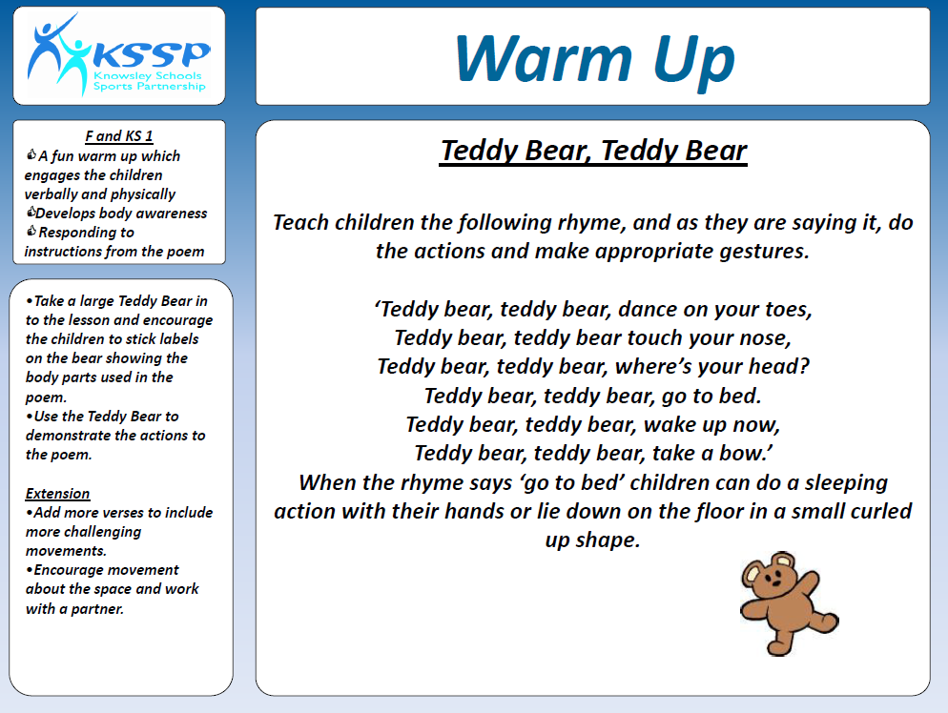
http://knowsleyssp.com/wp-content/uploads/2013/01/b780057a37afa52a1b9d3ca5f61bf820-1.pdf

Slide 7
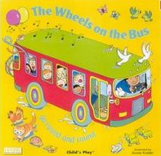
The wheels on the bus
The wheels on the bus go round and round Round and round, round and round The wheels on the bus go round and round All through the town The wipers on the bus go "Swish, swish, swish, Swish, swish, swish, swish, swish, swish" The wipers on the bus go "Swish, swish, swish" All through the town. The people on the bus go, "chat, chat, chat, cha,,chat chat,chat chat ,chat The people on the bus go, ", chat,chat,chat All through the town. The horn on the bus go "Beep, beep, beep Beep, beep, beep, beep, beep, beep" The horn on the bus go "Beep, beep, beep" All through the town.
The baby on the bus go, "wah, wah, wah! wah, wah, wah, wah, wah, wah!" The baby on the bus go, "wah, wah, wah!" All through the town. The mummy on the bus go, "ssss sh,ssss sh,ssss sh, ""ssss sh,ssss sh,ssss sh The mummy on the bus go, ""ssss sh,ssss sh,ssss sh" All through the town. The wheels on the bus go round and round Round and round, round and round The wheels on the bus go round and round All through the town
https://www.youtube.com/watch?v=yKc-ey5pnNo
Notes:
https://www.youtube.com/watch?v=yKc-ey5pnNo

Slide 8
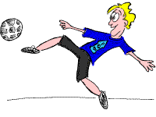
 | THE LITTLE RABBIT (Idea contributed by Keith Hooks)
Keith writes: 'Children all find a space in the hall and crouch into a ball. Teacher or another adult says rhyme: In a hole beneath the ground, Lives a rabbit without a sound, Slowly he wakes, (Children begin to slowly stretch up) Big breath he takes, (Children take a deep breath) He stretches his paws, (Children stretch arms and legs) He peers outdoors, (Children lean forward- stretching back- whilst peering using hands around eyes) Better not stay, He jumps away! (children jump around hall in a clockwise direction) Children listen for further instructions to change jump to hop, skip, walk etc (Run always causes problems!!!)'
http://www.primaryresources.co.uk/pe/littlerabbit.htm
Notes:
http://www.primaryresources.co.uk/pe/littlerabbit.htm

Slide 9
 | MONSTERS (Idea contributed by Barbara Otto)
Barbara writes: 'This is based on the film Monsters Inc.
Scary feet - lift foot off the floor, replace it then lift other foot off the floor etc as quickly as possible
Bunk bed scare - on tip toes , arms up, fingers clawed roar loudly. Then bend knees and repeat roar. Children must go from one to the other (repeatedly) as quickly as possible.
The kids awake - children lie down and be still and silent
Monster walk - take big strides, growling and waving arms.
Monster run - run as quickly as possible, waving arms and hissing loudly.
Explain each part of warm up to the children then pick different sections calling and changing them as necessary.
For safety issues make sure children all run the same way.
All the classes I have ever done p.e. with have loved this warm up. It raises the heart rate, puffs the children out and gets rid of excess energy including the teachers!'
http://www.primaryresources.co.uk/pe/monsters.htm
Notes:
http://www.primaryresources.co.uk/pe/monsters.htm

Slide 10
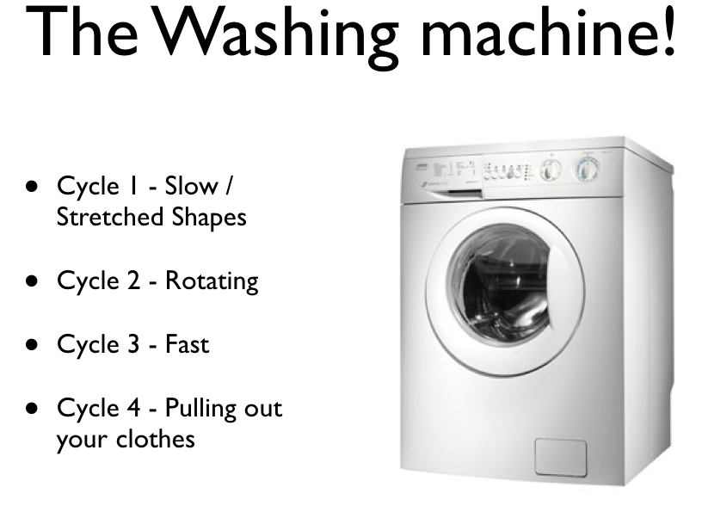

Slide 11

Car gears
Car gears
Children pretend they are driving a car and have to listen to the instructions: -
1st gear – slow walk
2nd gear – brisk walk
3rd gear – jog
4th gear – run
Reverse – carefully move backwards and look over your shoulder
Walk + “morning” & beep beep!
Skip
Sidestep
Jog
https://www.youtube.com/watch?v=ZhATPN-nYxU

Slide 12
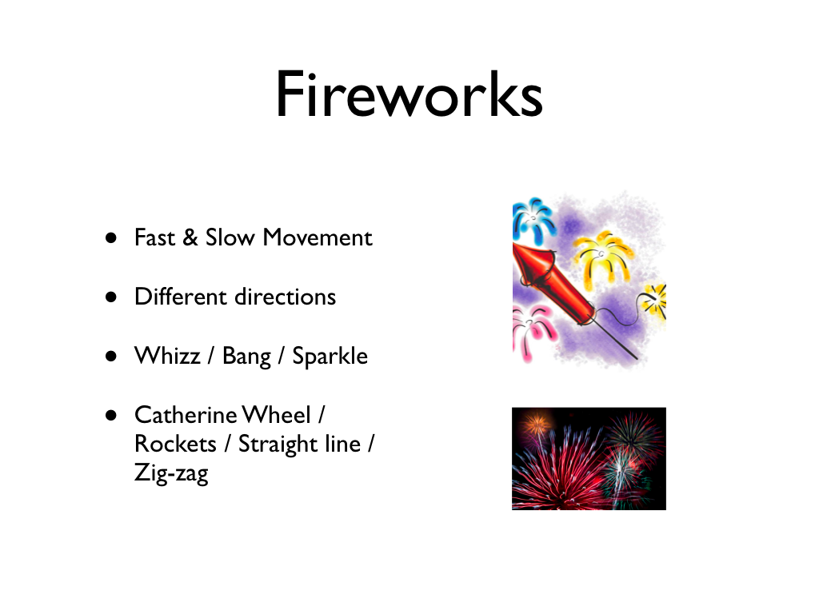

Slide 13
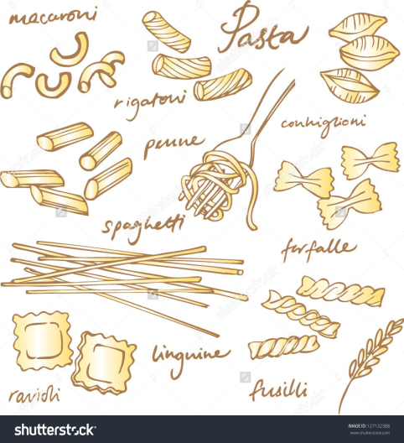
PASTA PE
The children should begin by walking around the room in any direction. On the various commands listed, they should carry out the appropriate action:
spaghetti - walk round the room tall and thin arms pointed together;
tagliatelle - walk round the room arms pointed side by side;
pasta twist - walk round the hall turning round and round;
pasta bow - walk round with legs and arms apart, bow shaped;
lasagne - lie flat on the floor; macaroni-make a circle with arms;
pasta shapes - make a 2D shape in small groups holding hands;
spaghetti hoops - make a 'hoop' in a small group holding hands;
cannelloni - roll on the floor;
ravioli - stand back to back with a partner.

Slide 14
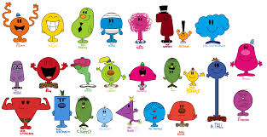
MUSICAL STATUES
Play some music and stop it at intervals. Get the children to do different actions: -
Pat head and rub tummy
The 3 wise monkeys
Tin of sardines
Groups of 3
Stand on 1 leg
V sit – you can relate these to your lesson or just have fun – the list is endless.
MR MEN
Mr. Slow - move slowly.
Mr. Rush - move fast.
Mr. Jelly - shake your whole body.
Mr. Muddle - walk backwards.
Mr. Bounce - bounce!
Mr. Small - crouch and move.
Mr. Strong - move flexing your muscles.
Mr. Tall - stretch up and move (good for stretching once the children's hearts are racing.)
Mr. Tickle - wave around your arms in a crazy way.
Mr. Happy - move around with big smiles on your face.

Slide 15

TRAFFIC LIGHTS
Red - Stop
Yellow - Run on the spot
Green - Run around the area
Roundabout - turn round once in a large circle
Speedbump - jump up and down.
Low bridge - everyone walks around hunched over / low to the ground
Traffic Jam – all stand in a line behind each other
Taxi – join with a partner and move around side by side
School Zone - slow walking, stop and slow walking again
Breakdown - lie down until rescued
Rain - use arms to mimic windscreen wipers
Zebra crossing – stand side by side in a long line
Lollipop person - children all put hands out in front of them and shout "stop"
Police Car - Sit on floor and spin round shouting "nee naw nee naw”

Slide 16
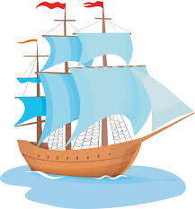
ABOARD SHIP
Command | Action
Port, starboard, stern, aft | Run to a wall / line on the sides of the area.
Man the lifeboats | sit on the floor and rock backwards and forwards (as in "row, row, row your boat").
Scrub the Decks | Children crouch down and pretend to clean the floor with their hands.
Climb the Rigging | Children pretend to climb a rope ladder.
Captain's Coming | Children salute
Man overboard | Children jump as if going over the side and then sink down holding nose with one hand and raising other hand in air as if going under water.
Walk the Plank | Children have to walk in a perfect straight line one foot exactly in front of the other with arms outstretched to the sides (children could also walk along benches).
Captain's Wife | Everyone curtseys
Captain's girlfriend | Children pose like a model (one hand on hip. the other outstretched and slightly bent) and say "Oo la la”
 | OR Children wiggle hips and blow a kiss.
Shark Attack | Move around with bent arm forming fin of shark
Hit the Deck | Children lie down on their stomachs as quickly as possible.
Rats on board | Children run fast on the spot
Bombs overhead | The children crouch and cover their head for 'protection'. They are not able to get up until 'All clear' is called. Anyone who gets up or moves before the 'all clear' is out.

Slide 17

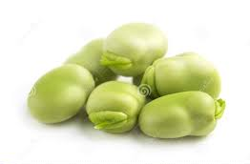


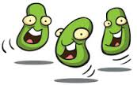
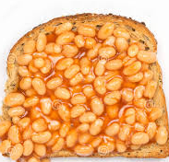
BEANS
Command | Action
JUMPING BEAN | Jump around the room
RUNNER BEAN | Running on the spot (more suitable for younger children than running around the room)
BROAD BEAN | Stretch your arms and legs out as wide as you can.
BAKED BEAN | Lay on the floor in a star shape until the next command is given.
 | OR Lie on floor and Sunbathe
JELLY BEAN | Wobble like a jelly
CHILLI BEAN | Shiver and shake
FROZEN BEAN | Children have to stand very still.
BEAN SPROUTS | Stand on tiptoes and make yourself as tall as possible.
BABY BEAN | Lie on the floor in the 'foetal' position
FRENCH BEANS | Strike a pose and shout "Oooh la la!"
KIDNEY BEANS | Make a Kidney shape on the floor
SANTA's BEEN | Walk about rubbing your tummy saying "Ho,Ho, Ho".
BEANSTALK | Children could start crouched on the floor and grow up slowly until they are straight and tall like the beanstalk in 'Jack and the Beanstalk'.
MAGIC BEAN | children skip around room waving a wand.
SUPER BEAN | Children freeze in an arabesque and can also make a suitable sound like Superman.

